Slide 1
Retail data warehouse Data integration

Slide 2
Talend jobs summary
Total Jobs
Dimensions : 10
Dim Promotion
Dim Geography
Dim Product
Dim Sales Territory
Dim Customer Company
Dim Customer Person
Dim Product Cost_SCD
Dim Product Price_SCD
Dim Store
Dim date and many more…
Facts : 6
Fact Online Sales
Fact sales
fact strategy plan
fact exchange rate
Fact Inventory
Fact Sales Quota

Slide 3
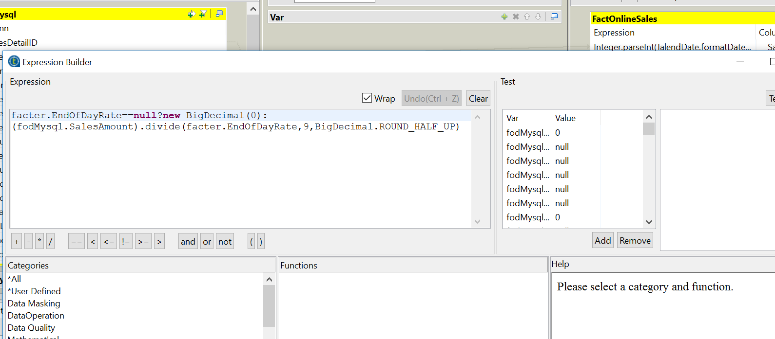
Currency conversion In Fact Table

Slide 4
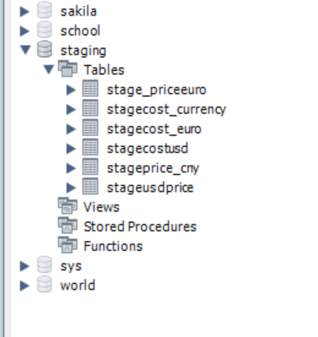
Staging area

Slide 5
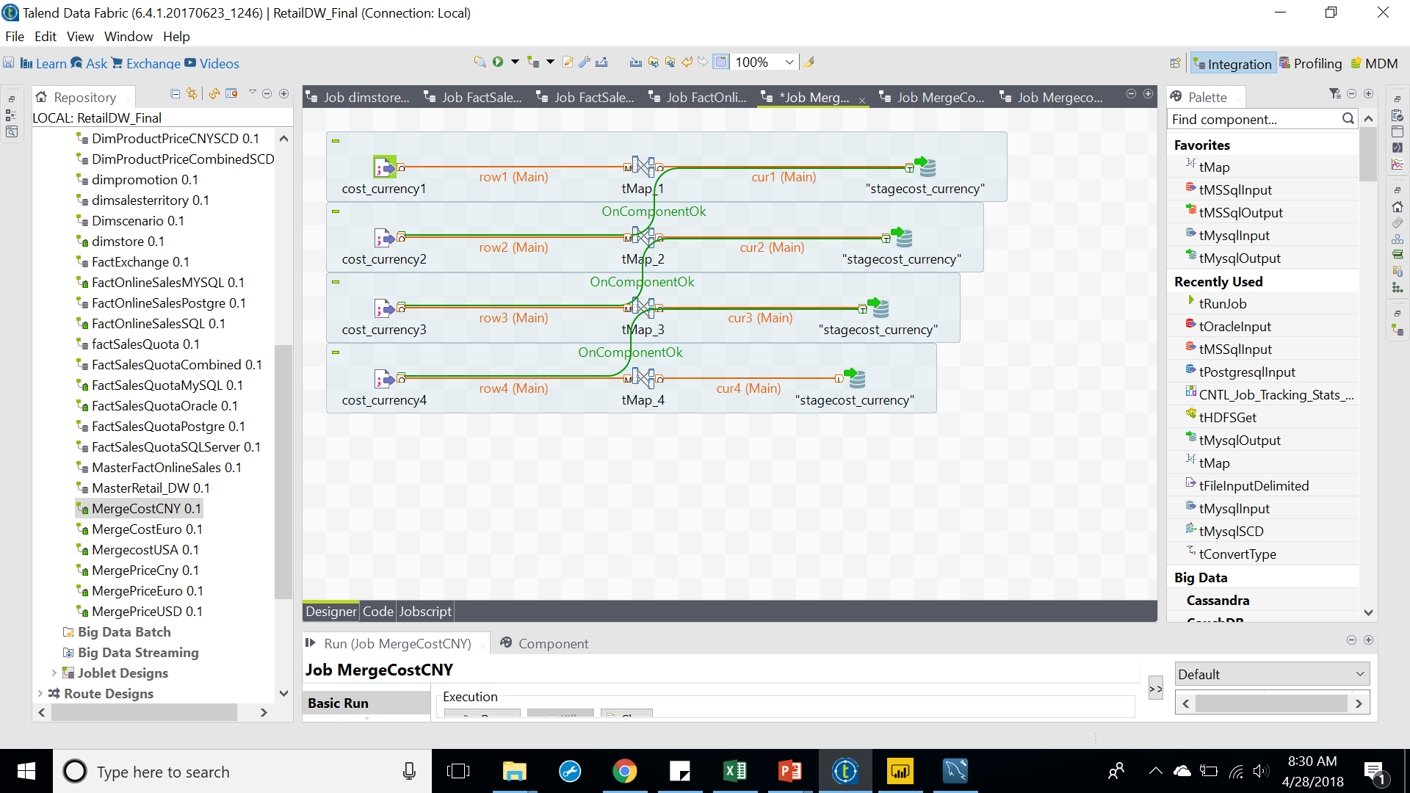
Cost currency

Slide 6
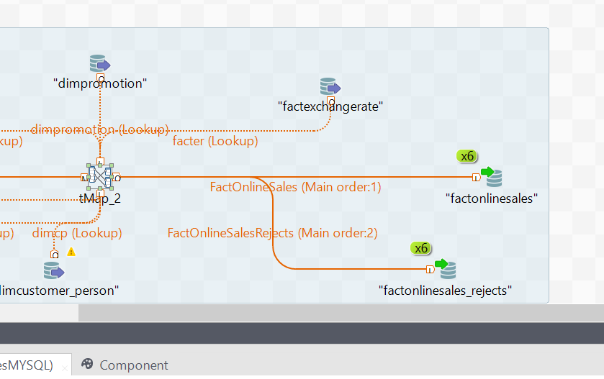
Tuning the jobs- Parallel execution and jvm size

Slide 7
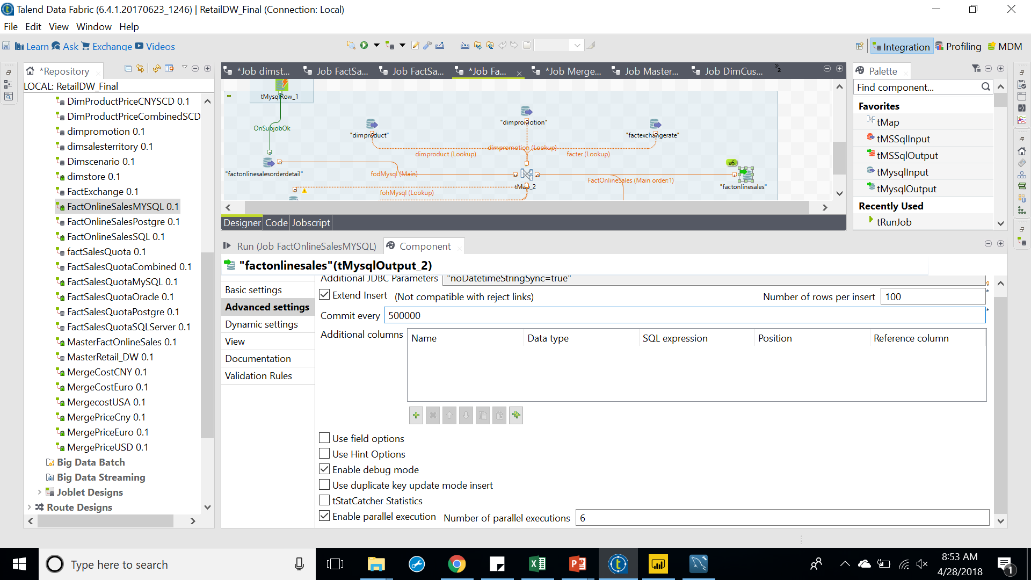




Slide 8
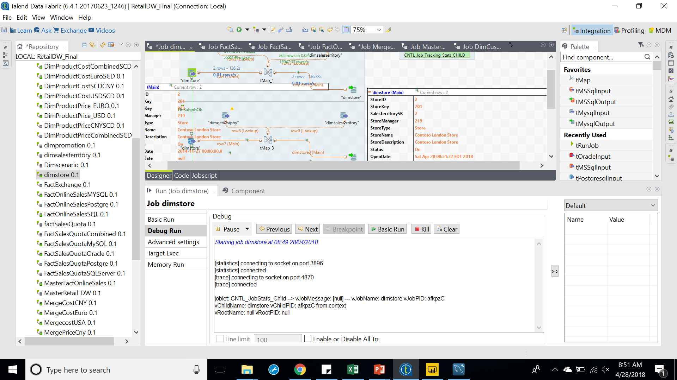
Running, testing and debugging

Slide 9
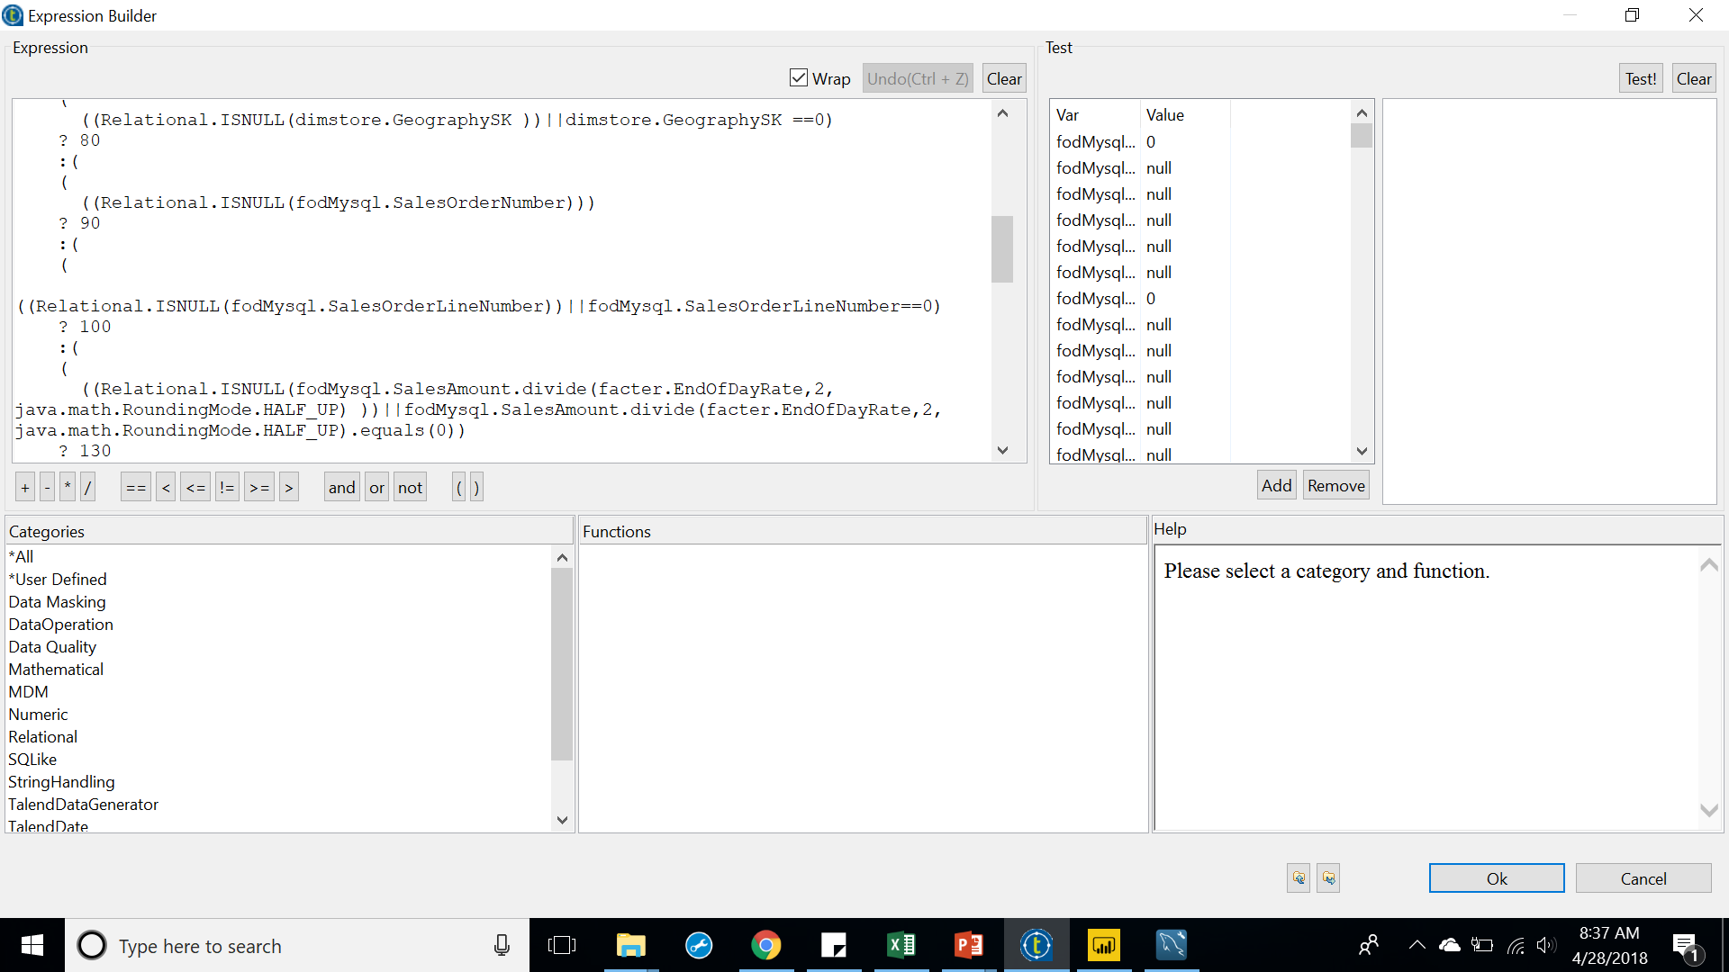
Reject codes sample

